Slide 1
Using Author Profiling to determine the
age of an Author
_________________________________________________________________
Amsterdam University College
Text Mining - 02/06/2022
Dan Hagen & Luca Nagel
_________________________________________________________________

Slide 2
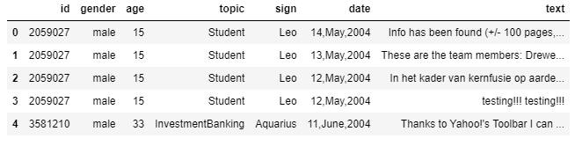
The Data Set
Blog Authorship Corpus from Kaggle:
681.288 blog posts
19.320 Authors
written in or before 2004
8240 blogs (ages 13-17)
8086 blogs (ages 23-27)
2994 blogs (ages 33-47)
→ 700 mb CSV file

Slide 3
Inspiration/ Idea from
Master thesis in Communication Technology (2019)
Eirik Holbæk of the Norwegian University of Science and Technology
Goal: determining the whether a text is written by a child (below the age of 18) or an adult (age 25 and above)

Slide 4
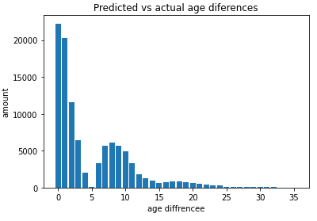
First Approach
Data set preparation
remove stop words, links etc.
tokenize
TFidf + CountVectorizer
LogisticRegression classifier
Average deviation: 4.84 years
Accuracy: 22%
Notes:
tweet tokenizer
tfidf + Countvoectorizer→ logreg as a classifier → pretty good already - average deviation 4.84 years, still outliers fe 35 years off → tried to optimize

Slide 5
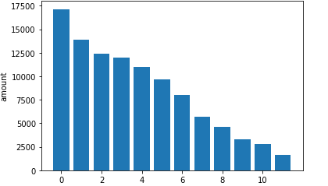

Comparison model
Star Signs:
Accuracy: 16%
Average deviation: 4 months

Slide 6
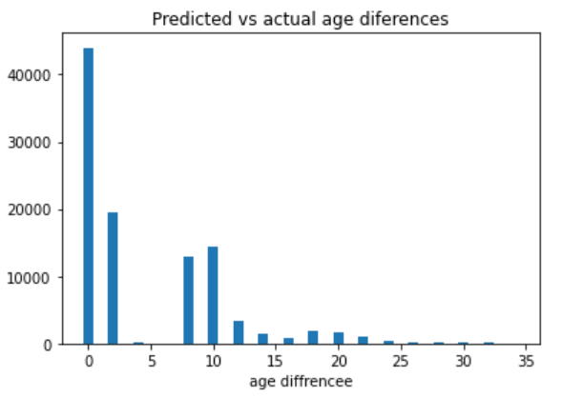


Grouped ages
2 year groups:
Accuracy: 45%
Average deviation: 4,5 years
vs
Accuracy: 81%

Slide 7

Further approaches
Logreg + ngrams:
First run : 50.000 blog entries
→ Accuracy 17% — Model very data hungry
→ Runtime 3h+
Second run: ~600.000 blog entries
→ Accuracy 30%
→ Runtime 7h+

Slide 8
Thanks For Listening

